Slide 1
Smart Room
project

Slide 2
Points of discussion
OVERVIEW
COMPONENTS
USES & CODE
CALLENGE FACED
HOW TO SOLVE IT
TINKERCAD MODEL & LINK
3D Model

Slide 3
Overview
It is a room built using Arduino and contains a set of
sensors that:
Count the Number of people inside it
Measure the Temperature
Measure the value of gas

Slide 4
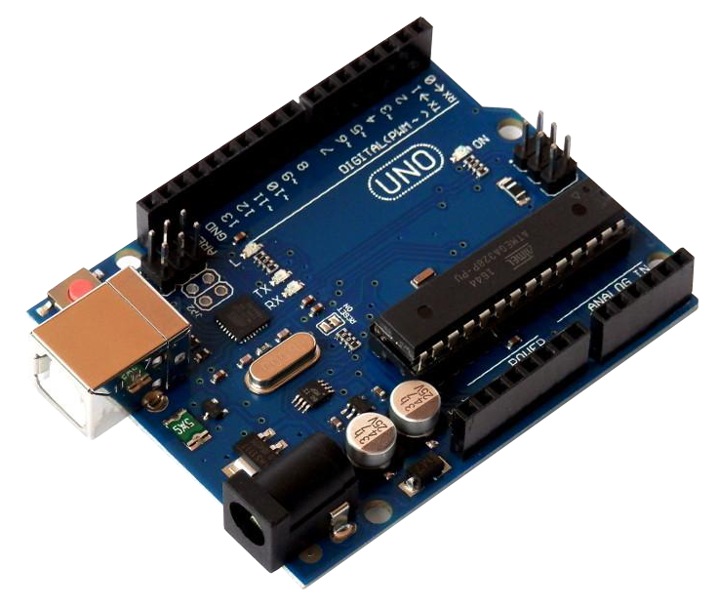
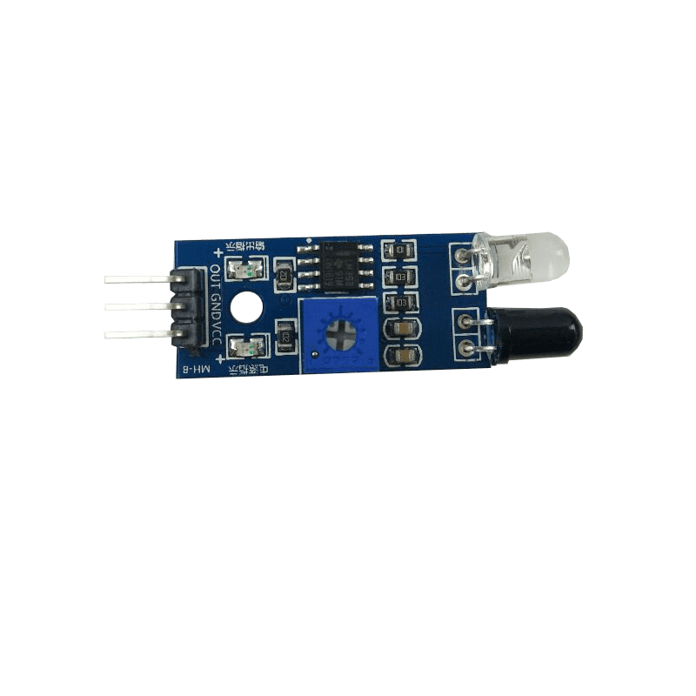
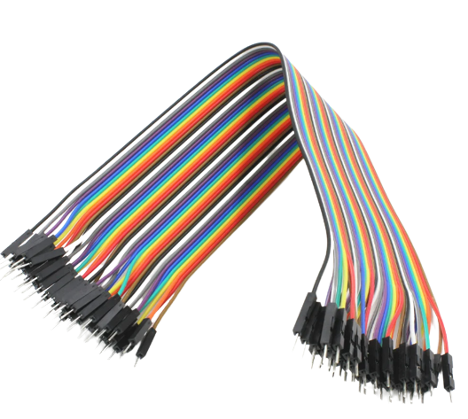
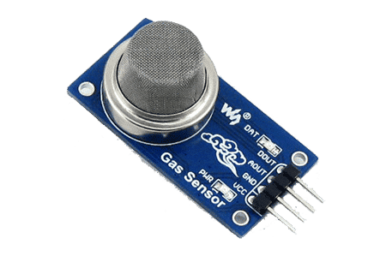



Arduino Uno R3 Atmega328p
Components
jumpers
MQ-2 Gas sensor
2 IR sensors
Buzzer
tmp35 Temperature sensor
2 Push buttons

Slide 5


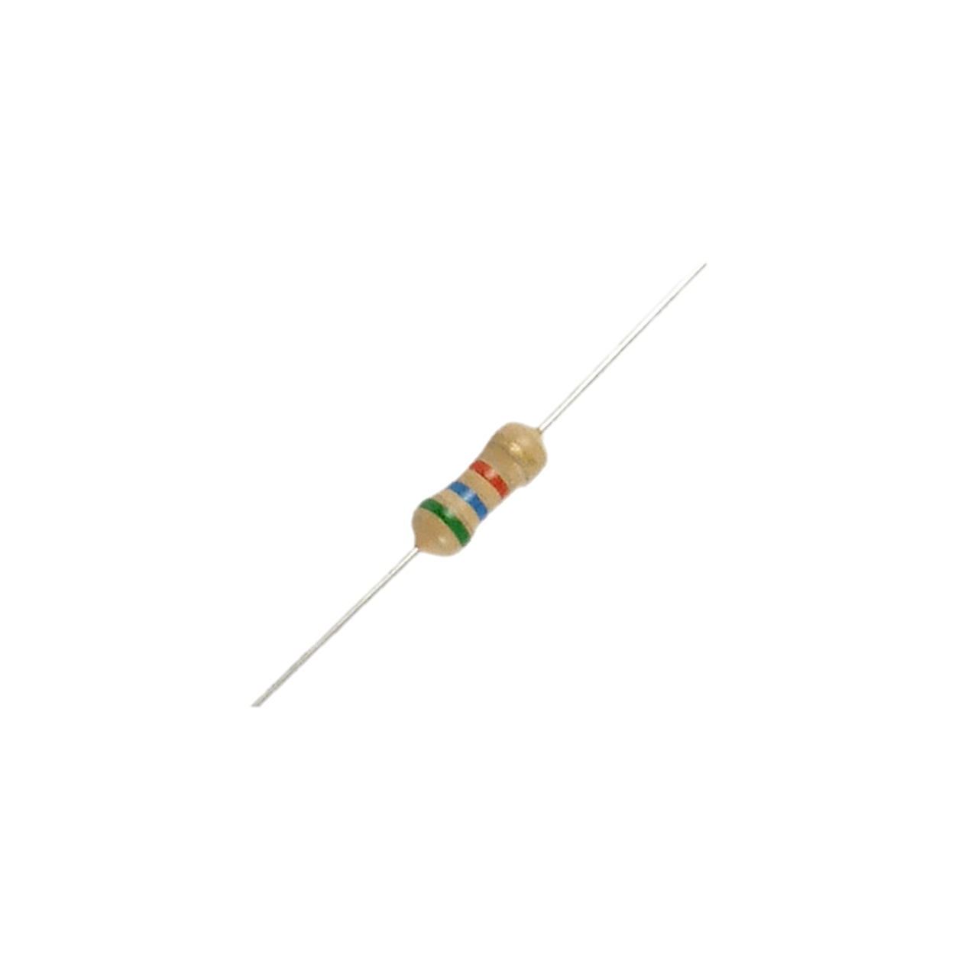
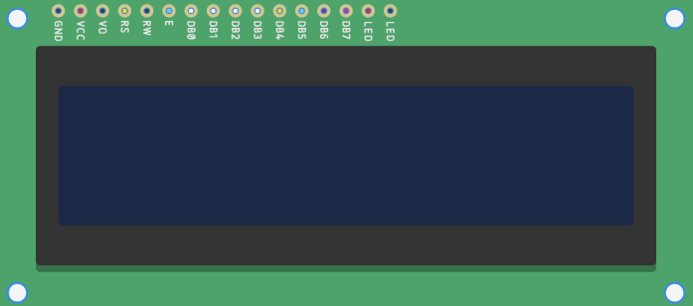
Components
2 LEDS
potentiometer
Resistors
(4 of 220ohm,1 of 330ohm,3 of 1kohm)
LCD
(Liquid-crystal display)

Slide 6
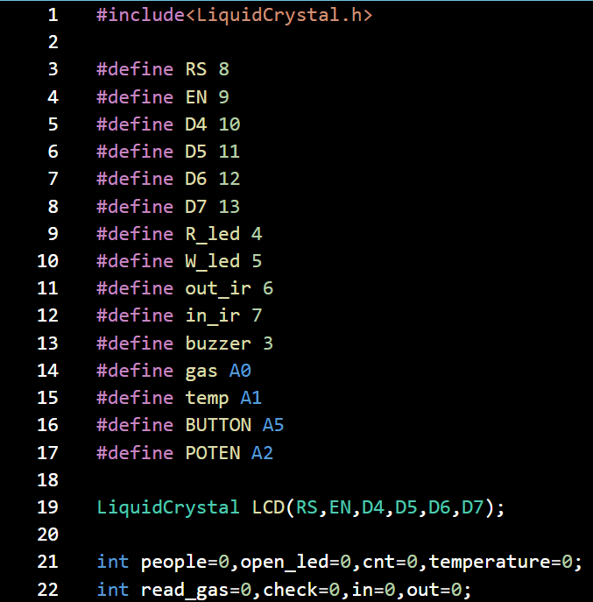
USES
1. Definition and Initialization
The first step is to write the LCD library, define the Arduino pins, and identify the variables that are used in the code.

Slide 7
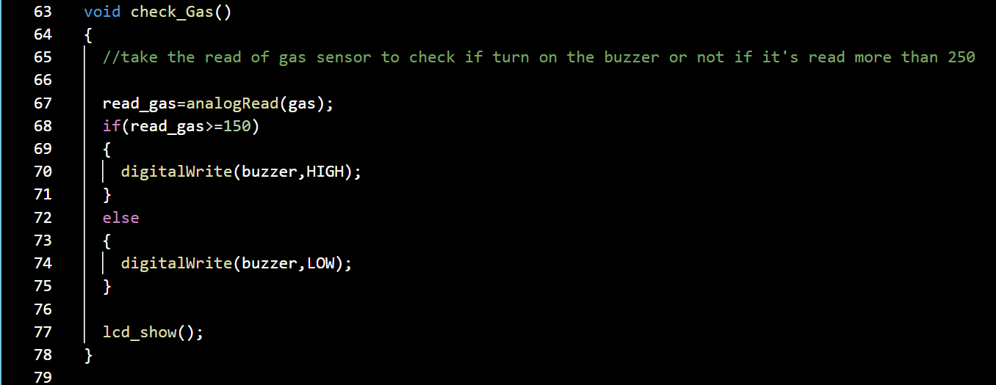
USES
2. Check gas function
We are using an MQ-2 Gas sensor to measure the percentage of gas present in a room. The readings of the gas sensor are stored in a variable named read_gas. If the reading is greater than or equal to 150 degrees, the buzzer will receive a high-voltage signal, otherwise, it will receive a low-voltage signal.

Slide 8
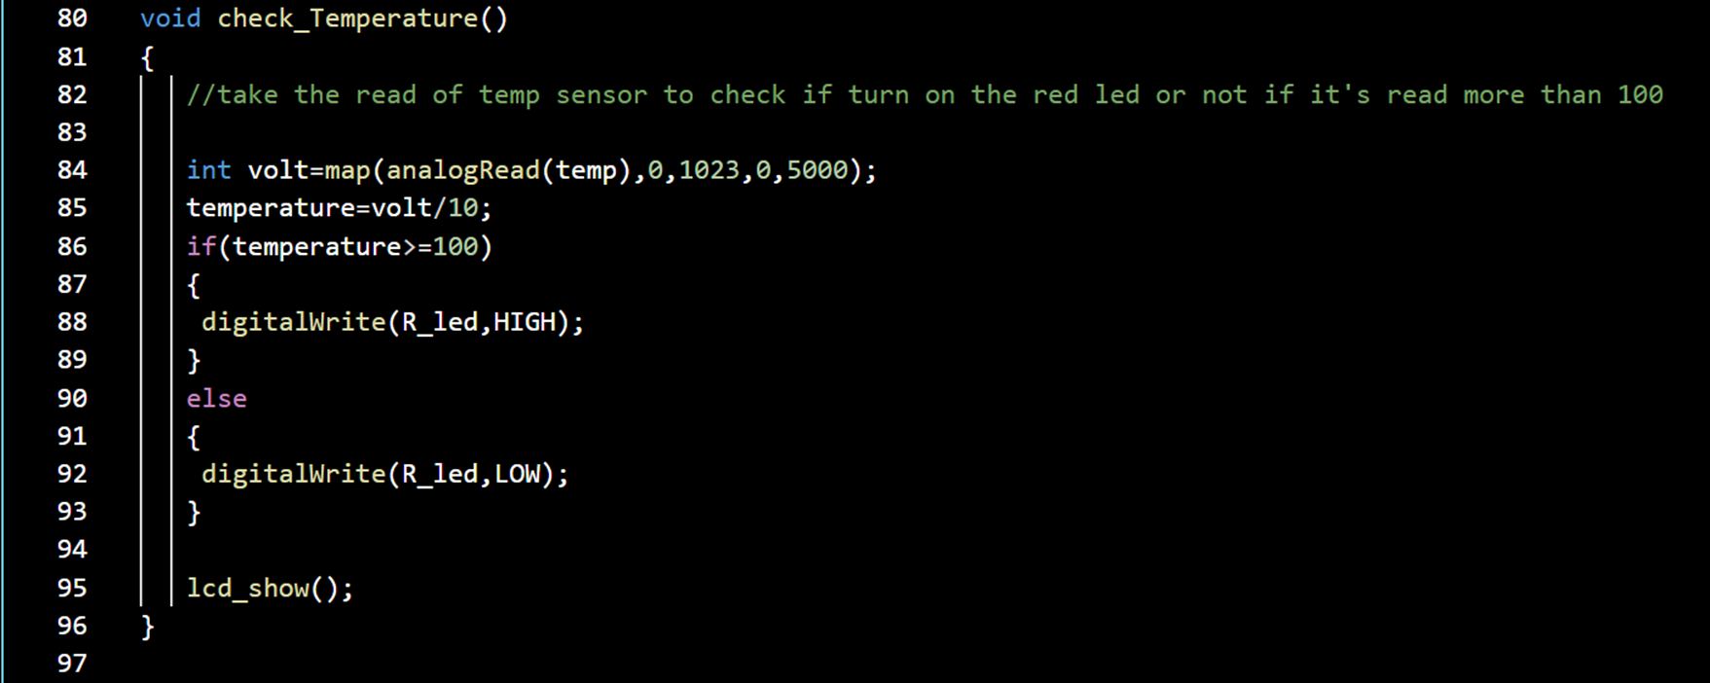
USES
3-Check Temperature
we are using tmp35 sensor to measure the temperature in the room , store the reading of it and maping it from range 0…1023 to 0…5000 and check if this temperature greater than or equals 100 turn on the red led else turn off .
In the end of this function call the lcd_show() function to show this reading in it
Question??

Slide 9
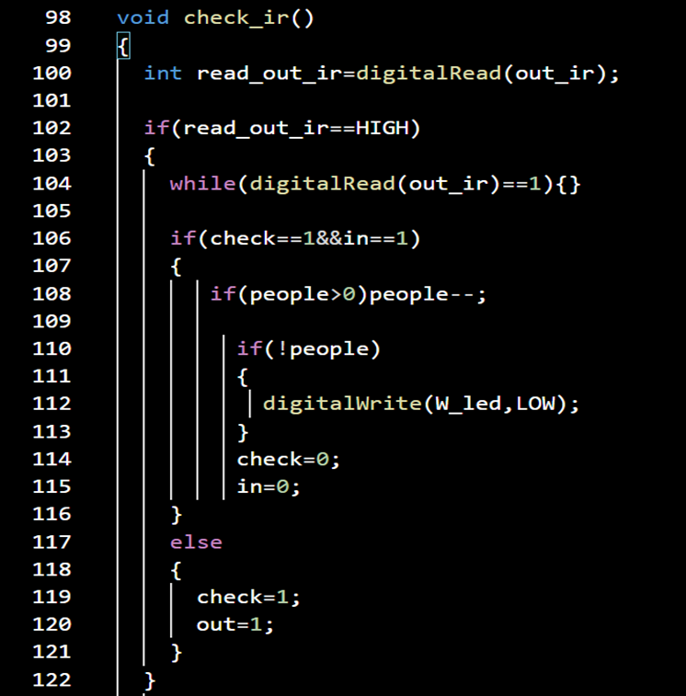
USES
4- Check the out_ir sensor
we are using an out_ir sensor to detect if the person wants to enter the room or wants to exit the room.
First, we put the check variable, in the flag and out flag equal zero which out flag refers to the person standing outside and wanting to enter the room, the in flag refers to the person standing inside and wanting to exit the room and the check variable refer to if the ir detect a person or not.
We first check if the check=1&& the flag in=1 this means this person exits the room, else he wants to enter so put check =1 and out =1

Slide 10
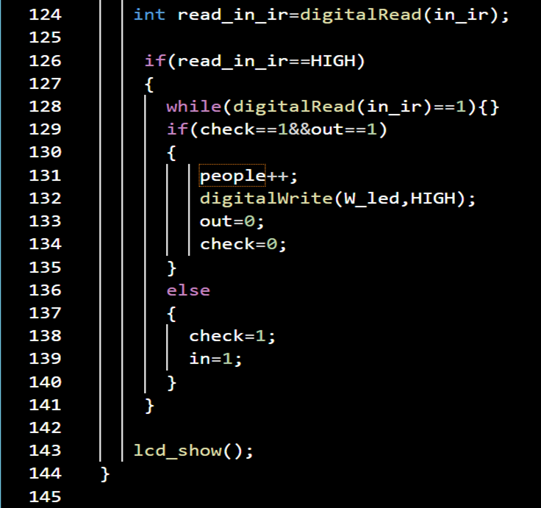
USES
4- Check the out_ir sensor
we are using the in_ir sensor to detect also if the person wants to enter the room or wants to exit the room.
We first check if the check=1&& the flag out=1 this means this person enters the room, else he wants to exit so put check =1 and in =1…
At the end of this function, we call the lcd_show() function to show the number of people in the room

Slide 11
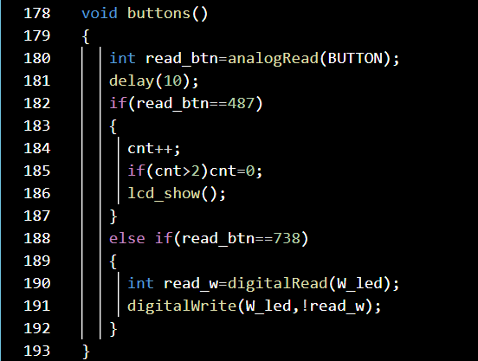
USES
5- Control of white LED and LCD by Buttons
These two buttons are connected as one button we use this method to minimize the number of used digital pins.
We take the reading of the button and wait 10 milliseconds to avoid the bouncing problem and if read_btn =487 so will increase the cnt variable to show the reading the user wants and call the lcd_show() function else if read_btn =738 reverse the reading of the LED…

Slide 12
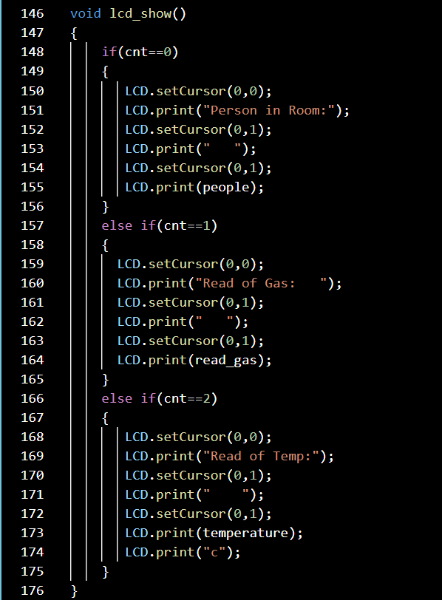
USES
6- Showing in LCD:
In this function, we show the number of people, percentage of Gas sensor, and Temperature sensor based on the press of the button…
Question??
Question??

Slide 13
Challenge we faced
We faced a challenge with LCD when changing the reading in it from high reading to low reading will output a false result

Slide 14
How to solve it
The first solution is using the clear function but when used there is blurry vision.
so we used the second solution which calculates the highest number will output and clear this by empty spaces instead of using the clear function…

Slide 15
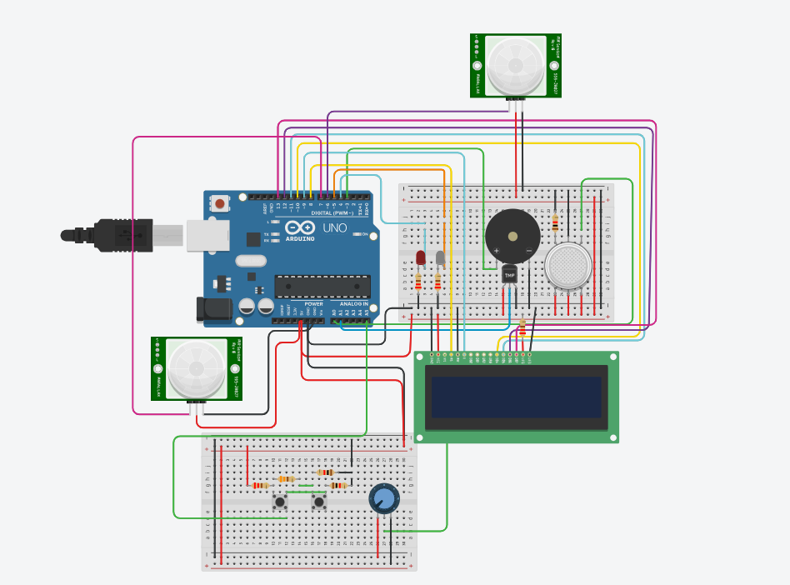
Tinkercad model
Take a look at this link.

Slide 16
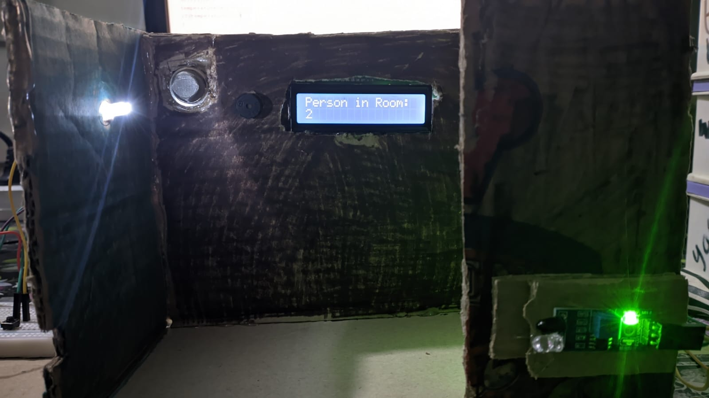
3D Model

Slide 17
Thank you

